Slide 1
Unit 1 Software project management concept

Slide 2
What is Software?
Software is: (1) instructions (computer programs) that when executed provide desired features, function, and performance; (2) data structures that enable the programs to adequately manipulate information and (3) documentation that describes the operation and use of the programs.

Slide 3
Software is developed or engineered, it is not manufactured in the classical sense.
Software doesn't "wear out."
Although the industry is moving toward component-based construction, most software continues to be custom-built.

Slide 4
What is good Software??
Various attributes that are associated with a software decides whether it is good or bad.
Specific set of attributes which one expects from software, depends on application
Banking system must be secure
Telephone system must be reliable
Interactive game must be responsive
Some attributes are:
Maintainability
Dependability
Efficiency
usability

Slide 5
Maintainability
Maintenance is very important and is critical to both software engineer and its user.
Software should be written in such a way that it may evolve to meet the changing need of customer.
Change is the software is required because of changing business environment, which are unavoidable.

Slide 6
Dependability
Software dependability has a range of sub-attributes:
Reusability through assured performance
Security
Safety
Dependable software should not cause physical or economical damage in the event of system failure.

Slide 7
Efficiency
Software should not make the wasteful use of the system resources such as memory, processor and storage.
Efficiency therefore includes:
Responsiveness
Processing time
Memory utilization

Slide 8
Usability
Software becomes useful if it does not call for extra effort to be learnt.
Usability increases with good documentation and an appropriate user interface.

Slide 9
Software Crisis
Software Crisis is a term used in computer science for the difficulty of writing useful and efficient computer programs in the required time .software crisis was due to using same workforce, same methods, same tools even though rapidly increasing in software demand, complexity of software and software challenges. With increase in the complexity of software, many software problems arise because existing methods were insufficient.
If we will use same workforce, same methods and same tools after fast increasing in software demand, software complexity and software challenges, then there arose some problems like software budget problem, software efficiency problem, software quality problem, software managing and delivering problem etc. This condition is called software crisis.

Slide 10
Reasons of Software Crisis
Lack of communication between software developers and users.
Increase in size of software.
Increase in cost of developing a software.
Project management problem.
Duplication of efforts due to absence of automation in most of the software development activities.

Slide 11
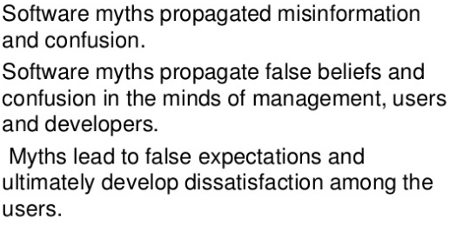
Software Myth

Slide 12
Software Myths – Management Perspective
"We already have a book that is full of standards and procedures for
building software. Won't that provide my people with everything they need to know?"
– Not used, not up to date, not complete, not focused on quality, time, and money
"If we get behind, we can add more programmers and catch up"
– Adding people to a late software project makes it later
– Training time, increased communication lines
"If I decide to outsource the software project to a third party, I can just relax and let that firm build it"
– Software projects need to be controlled and managed

Slide 13
Software Myths – Customer Perspective
"A general statement of objectives is sufficient to begin writing programs – we can fill in the details later"
– Ambiguous statement of objectives spells disaster
"Project requirements continually change, but change can be easily accommodated because software is flexible"
– Impact of change depends on where and when it occurs in the software life cycle (requirements analysis, design, code, test)

Slide 14
Software Engineering
The IEEE definition:
Software Engineering: (1) The application of a systematic, disciplined, quantifiable approach to the development, operation, and maintenance of software; that is, the application of engineering to software. (2) The study of approaches as in (1).

Slide 15
Software Process
A software process (also knows as software methodology) is a set of related activities that leads to the production of the software. These activities may involve the development of the software from the scratch, or, modifying an existing system.

Slide 16
Any software process must include the following four activities:
Software specification (or requirements engineering): Define the main functionalities of the software and the constrains around them.
Software design and implementation: The software is to be designed and programmed.
Software verification and validation: The software must conforms to it’s specification and meets the customer needs.
Software evolution (software maintenance): The software is being modified to meet customer and market requirements changes.

Slide 17
Software Process Models
A software process model is a simplified representation of a software process. Each model represents a process from a specific perspective.

Slide 18
1. Waterfall Model
The waterfall model is a sequential approach, where each fundamental activity of a process represented as a separate phase, arranged in linear order.
In the waterfall model, you must plan and schedule all of the activities before starting working on them (plan-driven process).

Slide 19
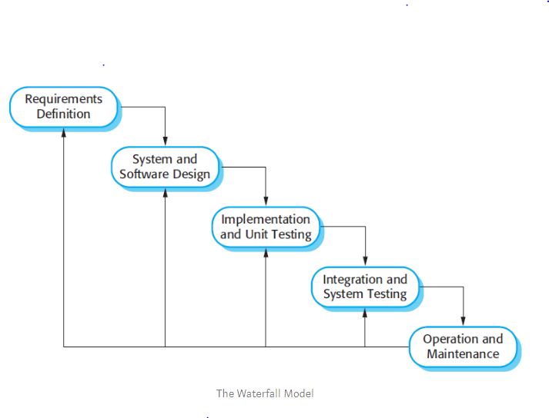

Slide 20
The Nature of Waterfall Phases
In principle, the result of each phase is one or more documents that should be approved and the next phase shouldn’t be started until the previous phase has completely been finished.
In practice, however, these phases overlap and feed information to each other. For example, during design, problems with requirements can be identified, and during coding, some of the design problems can be found, etc.
The software process therefore is not a simple linear but involves feedback from one phase to another. So, documents produced in each phase may then have to be modified to reflect the changes made.

Slide 21
When To Use?
In principle, the waterfall model should only be applied when requirements are well understood and unlikely to change radically during development as this model has a relatively rigid structure which makes it relatively hard to accommodate change when the process in underway.

Slide 22
2. Prototyping model
A prototype is a version of a system or part of the system that’s developed quickly to check the customer’s requirements or feasibility of some design decisions.
So, a prototype is useful when a customer or developer is not sure of the requirements, or of algorithms, efficiency, business rules, response time, etc.
In prototyping, the client is involved throughout the development process, which increases the likelihood of client acceptance of the final implementation. While some prototypes are developed with the expectation that they will be discarded, it is possible in some cases to evolve from prototype to working system.

Slide 23
A software prototype can be used:
[1] In the requirements engineering, a prototype can help with the elicitation and validation of system requirements.
It allows the users to experiment with the system, and so, refine the requirements. They may get new ideas for requirements, and find areas of strength and weakness in the software.
Furthermore, as the prototype is developed, it may reveal errors and in the requirements. The specification maybe then modified to reflect the changes.
[2] In the system design, a prototype can help to carry out deign experiments to check the feasibility of a proposed design.
For example, a database design may be prototype-d and tested to check it supports efficient data access for the most common user queries.

Slide 24
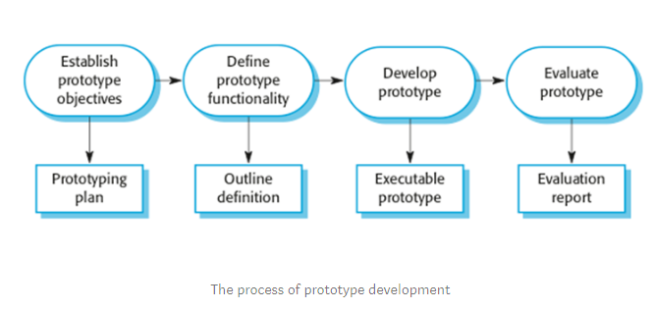

Slide 25
Phases of a prototype model
Establish objectives: The objectives of the prototype should be made explicit from the start of the process. Is it to validate system requirements, or demonstrate feasibility, etc.
Define prototype functionality: Decide what are the inputs and the expected output from a prototype. To reduce the prototyping costs and accelerate the delivery schedule, you may ignore some functionality, such as response time and memory utilization unless they are relevant to the objective of the prototype

Slide 26
Develop the prototype: The initial prototype is developed that includes only user interfaces.
Evaluate the prototype: Once the users are trained to use the prototype, they then discover requirements errors. Using the feedback both the specifications and the prototype can be improved. If changes are introduced, then a repeat of steps 3 and 4 may be needed.

Slide 27
3. Incremental Development
Incremental development is based on the idea of developing an initial implementation, exposing this to user feedback, and evolving it through several versions until an acceptable system has been developed.
The activities of a process are not separated but interleaved with feedback involved across those activities.

Slide 28
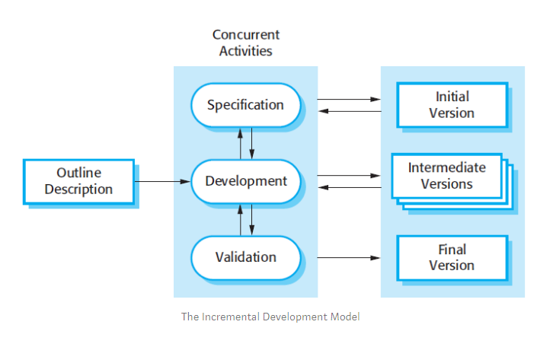

Slide 29
Each system increment reflects a piece of the functionality that is needed by the customer. Generally, the early increments of the system should include the most important or most urgently required functionality.
This means that the customer can evaluate the system at early stage in the development to see if it delivers what’s required. If not, then only the current increment has to be changed and, possibly, new functionality defined for later increments.

Slide 30
4. Spiral Model
The spiral model is a risk-driven where the process is represented as spiral rather than a sequence of activities.
It was designed to include the best features from the waterfall and prototyping models, and introduces a new component; risk-assessment.
Each loop (from review till service — see figure below) in the spiral represents a phase. Thus the first loop might be concerned with system feasibility, the next loop might be concerned with the requirements definition, the next loop with system design, and so on.

Slide 31
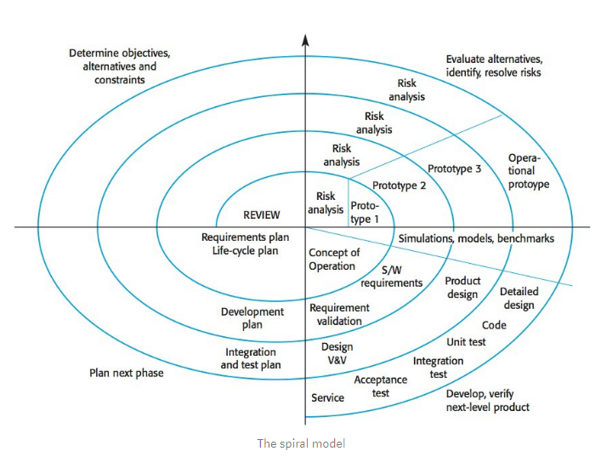

Slide 32
Each loop in the spiral is split into four sectors:
Objective setting: The objectives and risks for that phase of the project are defined.
Risk assessment and reduction: For each of the identified project risks, a detailed analysis is conducted, and steps are taken to reduce the risk. For example, if there’s a risk that the requirements are inappropriate, a prototype may be developed.

Slide 33
Development and validation: After risk evaluation, a process model for the system is chosen. So if the risk is expected in the user interface then we must prototype the user interface. If the risk is in the development process itself then use the waterfall model.
Planning: The project is reviewed and a decision is made whether to continue with a further loop or not.
Spiral model has been very influential in helping people think about iteration in software processes and introducing the risk-driven approach to development. In practice, however, the model is rarely used.

Slide 34
5. Iterative Development
Iterative development model aims to develop a system through building small portions of all the features, across all components.
We build a product which meets the initial scope and release it quickly for customer feedback. An early version with limited features important to establish market and get customer feedback.
In each increment, a slice of system features is delivered, passing through the requirements till the deployment.

Slide 35
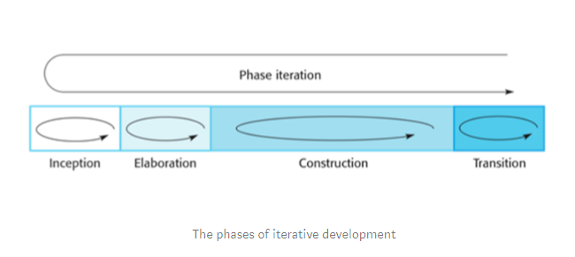

Slide 36
Phases of iterative development
Inception: The goal is to establish a business case for the system. We should identify all the external entities that will interact with the system, and define these interactions. Then, uses this information to assess the contribution that the system makes to the business. If the contribution is minor, then the project may be cancelled.
Elaboration: We develop an understanding of the problem domain and architecture framework, develop the project plan, and identify risks.

Slide 37
Construction: Incrementally fills-in the architecture with production-ready code produced from analysis, design, implementation, and testing of the requirements. The components of the system are dependent on each other and they’re developed in parallel and integrated during this phase. On the completion of this phase, you should have a complete working software.
Transition: We deliver the system into the production operating environment.
All the phases will be done once, while the construction phase will be incrementally visited for each increment; for each slice of system features.

Slide 38
Rapid Application Development (RAD)
Similar to waterfall but uses a very short development cycle (60 to 90 days to completion)
Uses component-based construction and emphasises reuse and code generation
Use multiple teams on scaleable projects
Requires heavy resources
Requires developers and customers who are heavily committed
Performance can be a problem
Difficult to use with new technology

Slide 39
Rapid Application Development (RAD)
Team 1
Team 2
Team 3
Business
modelling
Business
modelling
Business
modelling
Data modelling
Data modelling
Data modelling
Process modelling
Process modelling
Process modelling
Application
generation
Application
generation
Application
generation
Testing and turnover
Testing and turnover
Testing and turnover

Slide 40
Rapid Application Development (RAD)
RAD model can be applied successfully to the projects in which clear modularization is possible. If the project cannot be broken into modules, RAD may fail.
Following are the typical scenarios where RAD can be used:
RAD should be used only when a system can be modularized to be delivered in incremental manner.
It should be used if there is high availability of designers for modeling.
It should be used only if the budget permits use of automated code generating tools.
RAD SDLC model should be chosen only if domain experts are available with relevant business knowledge.
Should be used where the requirements change during the course of the project and working prototypes are to be presented to customer in small iterations of 2-3 months.

Slide 41
Four P's of Software Project Management
The effective software project management Focuses on four P's.
The People
The Product
The Process
The Project

Slide 42
1. People
The following categories of people are involved in the software process.
Senior Managers
Project Managers
Practitioners
Customers
End Users
Senior Managers define the business issue. Project Managers plan, motivate, organize and control the practitioners who do the Software work. Practitioners deliver the technical skills that are necessary to engineer a product or application. Customer specifies the requirements for the software to be developed. End Users interact with the software once it is released.

Slide 43
2. Product
Before a software project is planned, the product objectives and scope should be established, technical and management constraints should be identified. Without this information it is impossible to define a reasonable cost, amount of risk involved, the project schedule etc. A software project scope must be unambiguous and understandable at the management and technical levels. To develop a reasonable project plan we have to functionally decompose the problem to be solved.

Slide 44
3. Process
Here the important thing is to select an appropriate process model to develop the software.There are different process models available. They are Water fall model,Iterative waterfallmodel,Prototypingmodel,Evolutionary model,RAD(Rapid Application Development) model, Spiral model.In practice we may use any one of the above models or a combination of the above models.

Slide 45
4. Project
In order to manage a successful software project, we must understand what can go wrong (so that problems can be Avoided)and how to do it right. A project is a series of steps where we need to make accurate decision so as to make a successful project.

